Slide 1


Introduction to Linux
Basics of the Open-Source Operating System
www.herovired.com

Slide 2


Understanding Linux
What is Linux exactly?
Linux is an open-source operating system kernel originally developed by Linus Torvalds in 1991. Unlike proprietary systems, Linux gives users complete freedom to modify and distribute the code.
Today, Linux powers an incredible range of devices - from massive data centre servers to your Android smartphone, embedded systems in cars, and even space stations.

Slide 3




Key Advantages
Free & Open-Source
Secure & Stable
No licensing costs, complete source code access, and freedom to modify
Robust security model with regular updates and minimal downtime
Lightweight
Industry Standard
Runs efficiently on older hardware whilst remaining highly customisable
Dominant in servers, DevOps, cloud computing, and cybersecurity fields

Slide 4
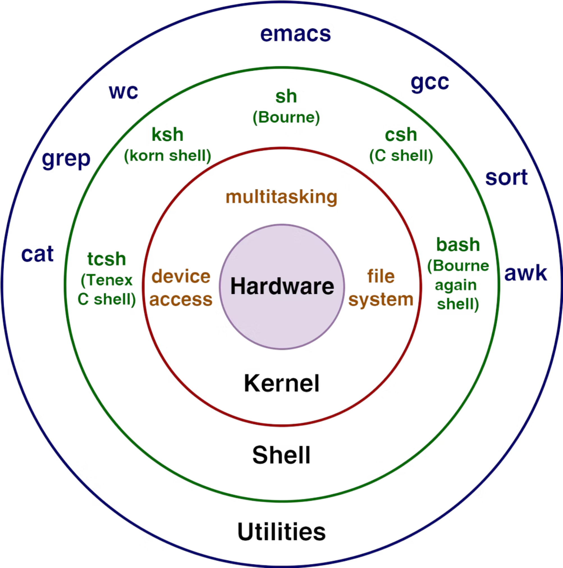




Core Components
Kernel
The core that manages hardware resources, memory, and system processes
Shell
Command-line interface that interprets user commands and executes programs
File System
Hierarchical structure organising files and directories across the system
Applications
User-level programs and utilities that provide functionality and services

Slide 5





Popular Linux Distributions
Ubuntu
Fedora
RHEL
Kali Linux
Perfect for beginners with user-friendly interface and extensive community support
Features cutting-edge software and latest technologies for developers
Enterprise-grade stability and support for mission-critical servers
Specialised distribution for security testing and penetration testing
Debian
Rock-solid stability with strong community governance and support

Slide 6
Directory Structure
Essential Directories
/ (Root)
/home
/etc
The base of the entire filesystem hierarchy
Contains user personal files and directories
System-wide configuration files and settings
/var
/bin & /sbin
Variable files including logs and temporary data
Essential system binaries and executables

Slide 7
Working with CLI
1
2
pwd
ls
Print working directory - shows your current location
List files and directories in current location
$ pwd/home/username
$ ls -la
total 24
drwxr-xr-x 3 user
3
4
cd
cat / nano
Change directory to navigate filesystem
View or edit file contents quickly
$ cd /home/documents
$ cat filename.txt
$ nano filename.txt

Slide 8
Managing Users & Access
User Identity
File Permissions
Use whoami and id to check current user information and permissions
r (read), w (write), x (execute) control access to files and directories
Permission Management
Superuser Access
chmod changes permissions whilst chown changes ownership of files
Root user has complete system control - use sudo for administrative tasks

Slide 9
Installing Software in Linux
Debian-Based Systems
Red Hat-Based Systems
Universal Package Managers
Ubuntu, Debian, and derivatives use APT
CentOS, RHEL, and Fedora use YUM/DNF
Cross-distribution solutions
$ sudo apt-get update
$ sudo apt-get install package-name
$ sudo yum install package-name
$ sudo dnf install package-name
$ sudo snap install package-name
$ flatpak install package-name
Software repositories function like app stores for Linux, providing thousands of pre-compiled packages ready for installation.

Slide 10





Applications of Linux
Server Infrastructure
DevOps & Cloud
Powers web servers, databases, mail servers, and enterprise applications worldwide
Essential for Docker containers, Kubernetes orchestration, AWS, Google Cloud Platform
Cybersecurity
IoT & Embedded
Kali Linux leads penetration testing, vulnerability assessment, and security research
Runs on routers, smart devices, automotive systems, and industrial equipment
Remarkable fact: Linux powers over 90% of the world's top supercomputers, demonstrating its scalability and performance capabilities.

Slide 11

Thank You
www.herovired.com
Wait Nahi, Great Kar!

